Slide 1
Unit II part 3
Threaded Binary Tree

Slide 2
Threaded Binary Tree
Two many null pointers in current representation of binary trees n: number of nodes number of non-null links: n-1 total links: 2n null links: 2n-(n-1)=n+1
Replace these null pointers with some useful “threads”.

Slide 3
Threaded Binary Tree
Binary trees have a lot of wasted space: the leaf nodes each have 2 null pointers
We can use these pointers to help us in inorder traversals
We have the pointers reference the next node in an inorder traversal; called threads
We need to know if a pointer is an actual link or a thread, so we keep a boolean for each pointer

Slide 4
Threaded Tree Traversal
We start at the leftmost node in the tree, print it, and follow its right thread
If we follow a thread to the right, we output the node and continue to its right
If we follow a link to the right, we go to the leftmost node, print it, and continue

Slide 5
Threaded Tree Traversal
Output
1
6
8
3
1
5
7
11
9
13
Start at leftmost node, print it

Slide 6
Threaded Tree Traversal
Output
1
3
6
8
3
1
5
7
11
9
13
Follow thread to right, print node

Slide 7
Threaded Tree Traversal
Output
1
3
5
6
8
3
1
5
7
11
9
13
Follow link to right, go to leftmost node and print

Slide 8
Threaded Tree Traversal
Output
1
3
5
6
6
8
3
1
5
7
11
9
13
Follow thread to right, print node

Slide 9
Threaded Tree Traversal
Output
1
3
5
6
7
6
8
3
1
5
7
11
9
13
Follow link to right, go to leftmost node and print

Slide 10
Threaded Tree Traversal
Output
1
3
5
6
7
8
6
8
3
1
5
7
11
9
13
Follow thread to right, print node

Slide 11
Threaded Tree Traversal
Output
1
3
5
6
7
8
9
6
8
3
1
5
7
11
9
13
Follow link to right, go to leftmost node and print

Slide 12
Threaded Tree Traversal
Output
1
3
5
6
7
8
9
11
6
8
3
1
5
7
11
9
13
Follow thread to right, print node

Slide 13
Threaded Tree Traversal
Output
1
3
5
6
7
8
9
11
13
6
8
3
1
5
7
11
9
13
Follow link to right, go to leftmost node and print

Slide 14
Threaded Tree Modification
We’re still wasting pointers, since half of our leafs’ pointers are still null
We can add threads to the previous node in an inorder traversal as well, which we can use to traverse the tree backwards or even to do postorder traversals

Slide 15
Threaded Tree Modification
6
8
3
1
5
7
11
9
13

Slide 16
Threaded Tree Traversal Code
Node leftMost(Node n) {
Node ans = n;
if (ans == null) {
return null;
}
while (ans.left != null) {
ans = ans.left;
}
return ans;
}
void inOrder(Node n) {
Node cur = leftmost(n);
while (cur != null) {
print(cur);
if (cur.rightThread) {
cur = cur.right;
} else {
cur = leftmost(cur.right);
}
}
}

Slide 17
Threaded Binary Trees (Continued)
If ptr->left_child is null,
replace it with a pointer to the node that would be
visited before ptr in an inorder traversal
If ptr->right_child is null,
replace it with a pointer to the node that would be
visited after ptr in an inorder traversal

Slide 18
A Threaded Binary Tree
root
A
dangling
B
C
dangling
D
E
F
G
inorder traversal:
H, D, I, B, E, A, F, C, G
H
I

Slide 19
Data Structures for Threaded BT
left_thread left_child data right_child right_thread
TRUE
●
●
FALSE
TRUE: thread
FALSE: child
Class threaded_treenode {
boolean left_thread;
threaded_treenode* left_child;
char data;
threaded_treenode* right_child;
boolean right_thread; };

Slide 20
Memory Representation of A Threaded BT
root
--
f
f
f
A
f
f
B
f
f
C
f
f
D
f
t
E
t
t
F
t
t
G
t
t
H
t
t
I
t

Slide 21
Inorder Traversal of Threaded BT
void tinorder(threaded_pointer temp)
{ while(temp!=dummy)
{ while(!temp->left_thread)
temp=temp->left
cout<<temp->data
while(temp->right_thread)
{temp=temp-> right
if(temp==dummy) return;
cout<<temp->data
}
temp=temp-> right
}
}
}

Slide 22
Inserting Nodes into Threaded BTs
Insert child as the right child of node parent
change parent->right_thread to FALSE
set child->left_thread and
child->right_thread to TRUE
set child->left_child to point to parent
set child->right_child to
parent->right_child
change parent->right_child to point to child

Slide 23
Examples
Insert a node D as a right child of B.
root
root
A
A
(1)
parent
B
parent
B
(3)
child
child
C
D
C
D
empty
(2)

Slide 24
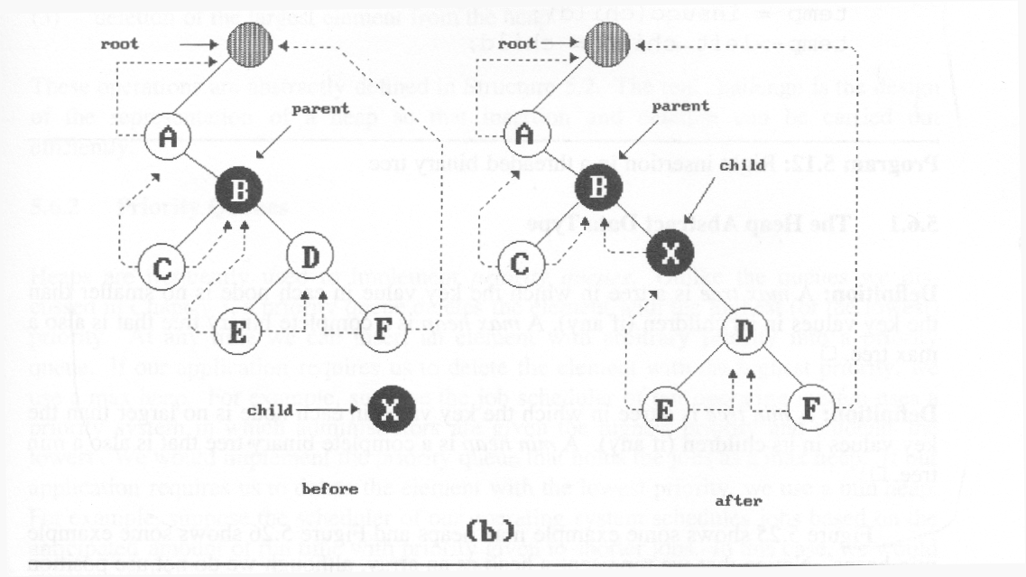
(3)
(2)
(1)
(4)
nonempty
Insertion of child as a right child of parent in a threaded binary tree

Slide 25
Right Insertion in Threaded BTs
void insert_right(threaded_pointer parent,
threaded_pointer child)
{
threaded_pointer temp;
child->right_child = parent->right_child;
child->right_thread = parent->right_thread;
child->left_child = parent; case (a)
child->left_thread = TRUE;
parent->right_child = child;
parent->right_thread = FALSE;
if (!child->right_thread) { case (b) temp = insucc(child);
temp->left_child = child;
}
}

Slide 26
Next Node in Threaded BT
threaded_pointer insucc(threaded_pointer tree)
{
threaded_pointer temp;
temp = tree->right_child;
if (!tree->right_thread)
while (!temp->left_thread)
temp = temp->left_child;
return temp;
}

Slide 27
Convert given binary tree into threaded binary tree
We first do an inorder traversal of the tree and store it in a queue so that the inorder successor becomes the next node. We again do an inorder traversal and whenever we find a node whose right is NULL, we take the front item from queue and make it the right of current node. We also set isThreaded to true to indicate that the right pointer is a threaded link
whenever we find a node whose left is NULL, we take the previous item from queue and make it the left of current node. We also set isThreaded to true to indicate that the left pointer is a threaded link
.

Slide 28
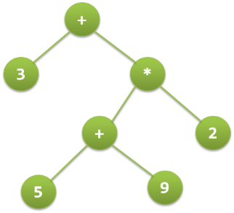
Case study: Use of binary tree in expression tree-evaluation and Huffman's coding
3 + ((5+9)*2)

Slide 29
Evaluating the expression represented by expression tree
Let t be the expression tree
If t is not null then
If t.value is operand then
Return t.value
A = solve(t.left)
B = solve(t.right)
// calculate applies operator 't.value'
// on A and B, and returns value
Return calculate(A, B, t.value)

Slide 30
Huffman code
Very often used for text compression
Do you know how gzip or winzip works?
→ Compression methods
ASCII code uses codes of equal length for all letters → how many codes?
Today’s alternative to ASCII?
Idea behind Huffman code: use shorter length codes for letters that are more frequent

Slide 31
The Basic Algorithm
Huffman coding is a form of statistical coding
Not all characters occur with the same frequency!
Yet all characters are allocated the same amount of space
1 char = 1 byte, be it e or x

Slide 32
The Basic Algorithm
Scan text to be compressed and tally occurrence of all characters.
Sort or prioritize characters based on number of occurrences in text.
Build Huffman code tree based on prioritized list.
Perform a traversal of tree to determine all code words.
Scan text again and create new file using the Huffman codes.

Slide 33
http://people.cs.pitt.edu/~kirk/cs1501/animations/Huffman.html
Suppose we have given following set of frequencies
a-1, b-2, c-3,d-4,e-5,f-6,g-7,h-8

Slide 34
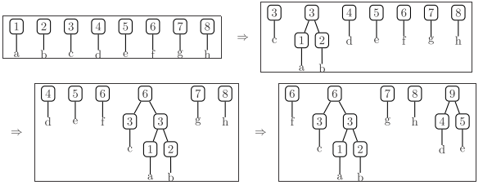

Slide 35
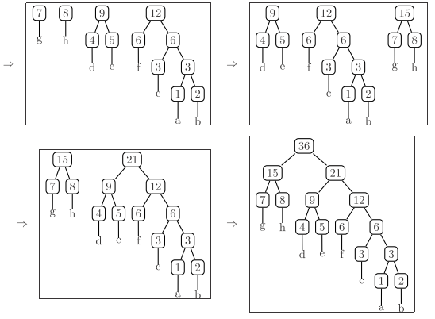

Slide 36


Slide 37
Huffman code generation
To generate a huffman code you traverse the tree from root to the value you want, outputing a 0 every time you take a lefthand branch, and a 1 every time you take a righthand branch.
Decoding a huffman encoding is just as easy : as you read bits in from your input stream you traverse the tree beginning at the root, taking the left hand path if you read a 0 and the right hand path if you read a 1. When you hit a leaf, you have found the code.

Slide 38
One more example
character Frequency
a 5
b 9
c 12
d 13
e 16
f 45

Slide 39
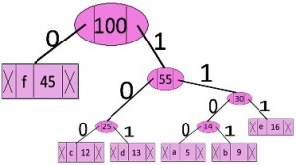
character code-word
f 0
c 100
d 101
a 1100
b 1101
e 111

Slide 40
Decode this string
1101111100101111001

Slide 41
struct node
{
char data;
int freq;
node *left, *right;
node(char data, int freq)
{
left = right = NULL;
this->data = data;
this->freq = freq;
}
};
struct compare
{
bool operator()(node* l, node* r)
{
return (l->freq > r->freq);
}
};

Slide 42
void HuffmanCodes(char data[], int freq[], int size)
{
struct node *left, *right, *top;
priority_queue<node*, vector<node*>, compare> minHeap;
for (int i = 0; i < size; ++i)
minHeap.push(new node(data[i], freq[i]));
while (minHeap.size() != 1) {
left = minHeap.top();
minHeap.pop();
right = minHeap.top();
minHeap.pop();
top = new node('$', left->freq + right->freq);
top->left = left;
top->right = right;
minHeap.push(top);
}
printCodes(minHeap.top(), "");
}

Slide 43
void printCodes(struct node* root, string str)
{
if (!root)
return;
if (root->data != '$')
cout << root->data << ": " << str << "\n";
printCodes(root->left, str + "0");
printCodes(root->right, str + "1");
}
int main()
{char arr[] = { 'a', 'b', 'c', 'd', 'e', 'f' };
int freq[] = { 10, 5, 14, 14, 7, 9 };
cout<<"The Character and its Frequency:- "<<endl;
int size = sizeof(arr) / sizeof(arr[0]);
for(int i=0;i<sizeof(arr);i++)
{
cout<<"\t"<<arr[i]<<"\t"<<freq[i]<<endl;
}
cout<<"The Huffman Codes:- "<<endl;
HuffmanCodes(arr, freq, size);
return 0;
}

